Slide 1
Capstone Engagement
Assessment, Analysis, and Hardening of a Vulnerable System

Slide 2
Table of Contents
This document contains the following sections:
01
Network Topology
02
Red Team: Security Assessment
03
Blue Team: Log Analysis and Attack Characterization
Hardening: Proposed Alarms and Mitigation Strategies
04

Slide 3
Network Topology
‹#›

Slide 4
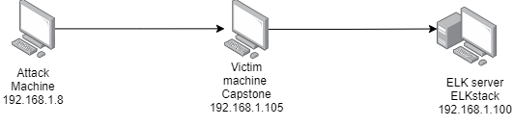
Network Topology
Network
Address Range:192.168.1.1/225
Netmask: 255.255.240.0
Gateway: 10.0.0.1
Machines
IPv4: 192.168.1.100
OS: Windows
Hostname: ELK
IPv4: 192.168.1.8
OS: Linux
Hostname: Kali
IPv4: 192.168.1.105
OS: Linux
Hostname: Capstone
IPv4: 192.168.1.1
OS: windows
Hostname: Red vs Blue

Slide 5

Red Team
Security Assessment
‹#›

Slide 6
Recon: Describing the Target
Nmap identified the following hosts on the network:
Hostname | IP Address | Role on Network
Red vs Blue | 192.168.1.1 | View logs
Kali | 192.168.1.8 | Attack Machine
Capstone | 192.168.1.105 | Victim machine
ELK | 192.168.1.100 | Activity logging from Capstone

Slide 7
Vulnerability Assessment
The assessment uncovered the following critical vulnerabilities in the target:
Vulnerability | Description | Impact
Port 80 is open | Leaving port open can allow attackers to access the system | Attackers can gain access to your data and also make changes.
Brute force attack capability | Attackers can guess passwords without a limit. | Attackers can login in using someone else’s credentials and gain access to data.
Saving password hash | Once a hash is generated for a password it should not be saved, if it is attackers can gain access to and try to crack the password. | Attackers can login in using someone else’s credentials and gain access to data.

Slide 8
Exploitation: [Port 80 open]
01
02
03
Tools & Processes
Used nmap to scan for any open ports.
Achievements
Found that port 80 was open in IP address 192.168.1.105
Nmap 192.168.1.0/24

Slide 9
Exploitation: [Brute force password]
01
02
03
Tools & Processes
Used Hydra to brute force a user’s password.
Achievements
Using the username and password we were able to log in to the victim’s machine.
hydra -l ryan -P rockyou.txt.gz -s 4444 -f -vV 192.168.1.105 http-get /company_folder/secret_folder

Slide 10
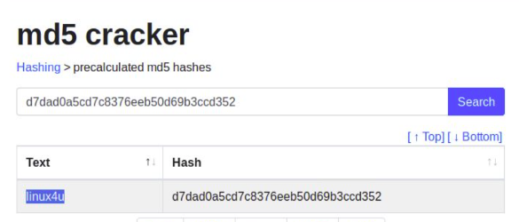
Exploitation: [Saving hashed password]
01
02
03
Tools & Processes
Used online hash cracker tool.
Achievements
Since the hashed password was saved we were able to crack that and logged in the victim machine using that username and password

Slide 11

Blue Team
Log Analysis and Attack Characterization
‹#›

Slide 12

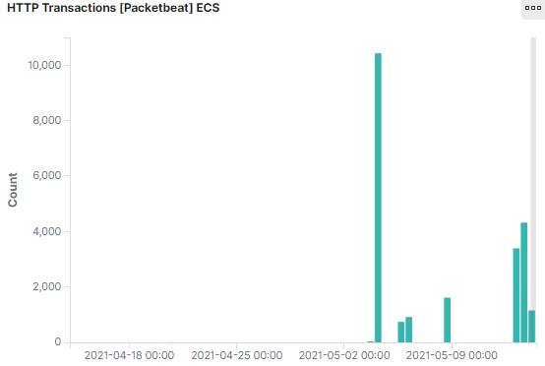
Analysis: Identifying the Port Scan
Answer the following questions in bullet points under the screenshot if space allows. Otherwise, add the answers to speaker notes.
Port scans began around midnight.
12,508 scans from 192.168.1.10
nmap sends ping to the ports.

Slide 13
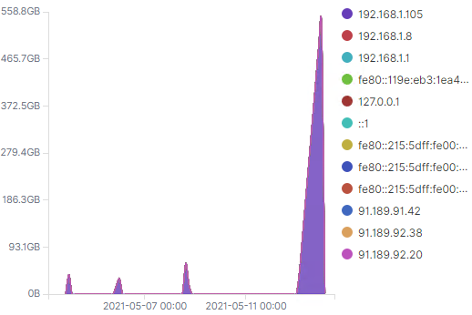
Analysis: Finding the Request for the Hidden Directory
Answer the following questions in bullet points under the screenshot if space allows. Otherwise, add the answers to speaker notes.
Request occurred around 3 am and the count was 9,978
Files in secret_folder were requested which contained password hashes.

Slide 14
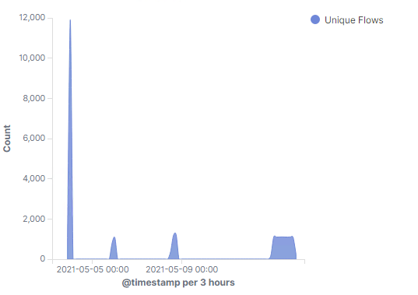
Analysis: Uncovering the Brute Force Attack
Answer the following questions in bullet points under the screenshot if space allows. Otherwise, add the answers to speaker notes.
11,906 requests were made before the attacker found the password.

Slide 15
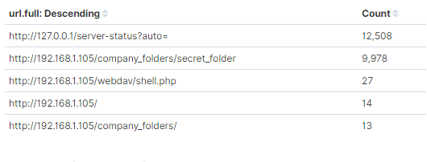
Analysis: Finding the WebDAV Connection
Answer the following questions in bullet points under the screenshot if space allows. Otherwise, add the answers to speaker notes.
27 requests were made to this directory
shell.php file was requested.

Slide 16
Blue Team
Proposed Alarms and Mitigation Strategies
‹#›

Slide 17
Mitigation: Blocking the Port Scan
We can set a firewall alarm that alerts us if ports are scanned.
We would set an alarm if the firewall detects more than 10 port scans per minute.
Whitelist IP addresses.
Only allow authorized IP addresses to access the system and block the rest.

Slide 18
Mitigation: Finding the Request for the Hidden Directory
We can set an alarm that watches for machines that access the specified directory/file.
We can set the alarm so that it alerts us when the directory/file is accessed by an unauthorized machine.
We can remove the file from the server.
We can move it to a safer location or an offline location.

Slide 19
Mitigation: Preventing Brute Force Attacks
We can set an alarm that watches for unsuccessful login attempts
We should limit unsuccessful login attempts to 10.
After the threshold is reached we can block the offending IP.

Slide 20
Mitigation: Detecting the WebDAV Connection
We can create an alarm that watches when this directory is accessed by unauthorized user.
We can have this alarm alert us when more than 1 attempt is made to access this directory
We can restrict access to this folder by machine.
We can have 2 factor authorization to access this directory and one of which can be using the authorized machine.

Slide 21
Mitigation: Identifying Reverse Shell Uploads
We can set an alarm to alert us when a .php file is uploaded to the server.
Threshold should be for any attempt to download/upload .php file to the server.
We can make this directory read only.
We can restrict access for anyone to upload files to this directory over the web interface.

